Slide 1

IMDB Movie Analysis Final Project -1
Submitted by- Mahalakshmi Sreenivasan
Notes:
To change the image on this slide, select the picture and delete it. Then click the Pictures icon in the placeholder to insert your own image.

Slide 2
PROJECT DESCRIPTION
I have been given a dataset consisting of various columns of different IMDB Movies. After cleaning the data, I must use my Data Analytics skills to derive various insights. The 5 Whys Analysis must be performed to convey a data story.
Concepts of Statistics and MS Excel are used to analyze the dataset and obtain the required results.

Slide 3
PROJECT APPROACH
Firstly, I went through the given IMDB dataset and performed data cleaning to remove the unwanted columns, rows and outliers. Then, I used the various functions of Statistics and MS Excel to obtain the various rankings of data and hence, the required result.

Slide 4

TECH STACK USED
MS Excel 2016 is the backbone software for this project.
It is the major tool for handling data by all industries. It has powerful data analysis capabilities. MS Excel allows to easily import, explore, clean, analyze, and visualize data through charts,

Slide 5
INSIGHTS
On analyzing the IMDB Movie Dataset, I've got a deeper understanding of Data Cleaning and Outlier Removal
The usage of MS Excel commands to determine Descriptive and Inferential Statistics has become clearer.
I can implement the Statistical Functions and study through the datasets in a much better way.

Slide 6
RESULTS

Slide 7
Cleaning the data: This is one of the most important step to perform before moving forward with the analysis. Use your knowledge learned till now to do this. (Dropping columns, removing null values, etc.) Your task: Clean the data
The Cleaning of Data involves the deletion of unwanted columns and rows. Here, the columns including ‘color’, ‘duration’, ‘director_facebook_likes’, ‘actor_3_facebook_likes’, ‘actor_2_name’, ‘actor_1_facebook_likes’, ‘cast_total_facebook_likes’, ‘actor_3_name’, ‘facenumber_in_poster’, ‘plot_keywords’, ‘movie_imdb_link’, ‘content_rating’, ‘actor_2_facebook_likes’, ‘aspect_ratio’, ‘movie_facebook_likes’ are removed as they contain irrelevant data.
After dropping such columns, the duplicate rows and blank or NULL values have to be removed. This is done using the ‘Remove Duplicates’ Option.

Slide 8
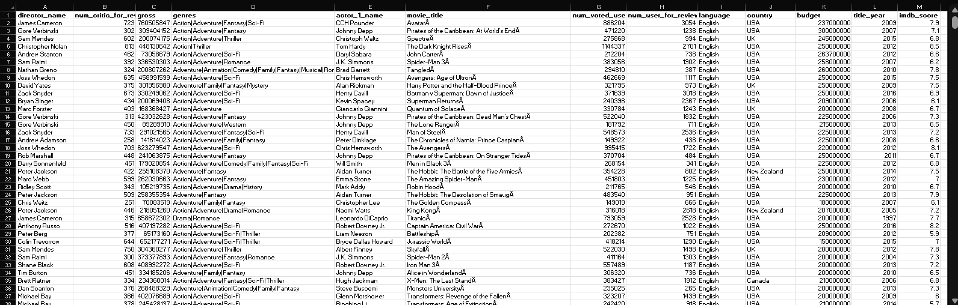

Slide 9
Number of rows in the table after cleaning = 3850

Slide 10
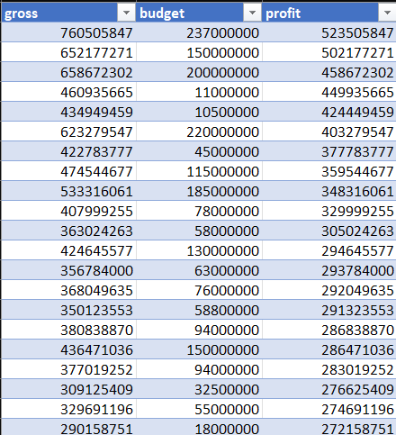
B. Movies with highest profit: Create a new column called profit which contains the difference of the two columns: gross and budget. Sort the column using the profit column as reference. Plot profit (y-axis) vs budget (x- axis) and observe the outliers using the appropriate chart type. Your task: Find the movies with the highest profit?
Columns ‘profit’ is created with value as ‘gross’-’budget’.
It is sorted in descending order.
Number of rows = 3850

Slide 12
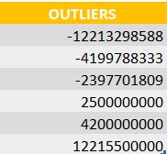

Slide 13
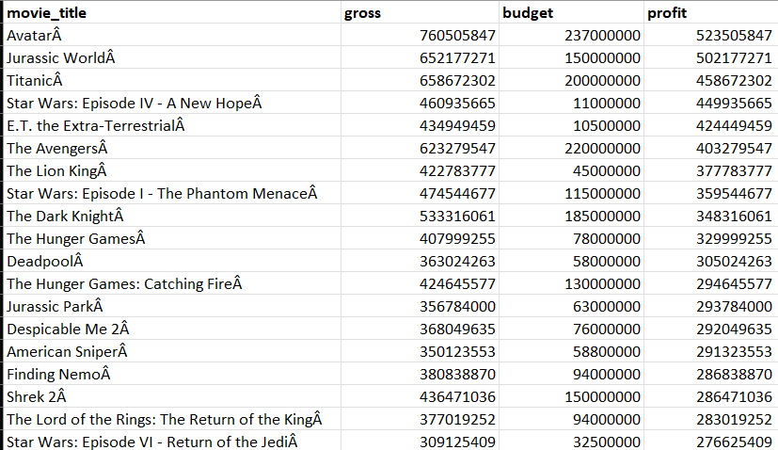
Top 20 movies with highest profit: It is found after sorting the profit in descending order.

Slide 14
C. Top 250: Create a new column IMDb_Top_250 and store the top 250 movies with the highest IMDb Rating (corresponding to the column: imdb_score). Also make sure that for all of these movies, the num_voted_users is greater than 25,000. Also add a Rank column containing the values 1 to 250 indicating the ranks of the corresponding films. Extract all the movies in the IMDb_Top_250 column which are not in the English language and store them in a new column named Top_Foreign_Lang_Film. You can use your own imagination also! Your task: Find IMDB Top 250
For this, the columns ‘movie_title’, ‘num_voted_users’, ‘language’, and ‘imdb_score’ are selected. The descending order sorting is done on the column ‘imdb_score’.
Using Conditional Formatting, the num_voted_users>25000 are obtained.
Finally, using RANK() function, the ranks of each row are obtained.

Slide 15
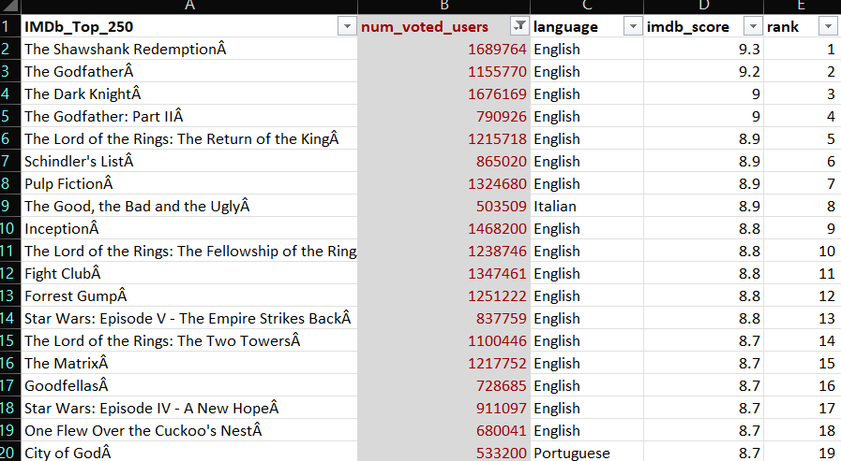
IMDb Top 250 Movies (Including English)

Slide 16
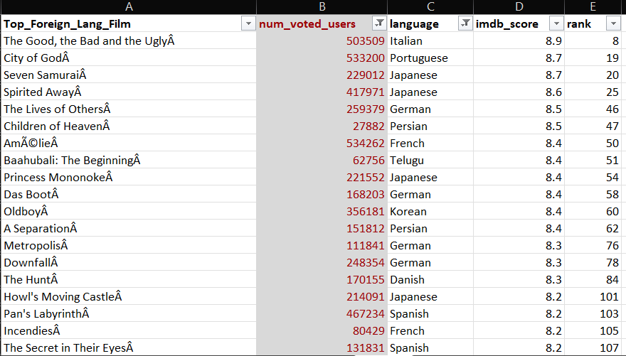
IMDb Top Foreign Language Movies (Excluding English)

Slide 17
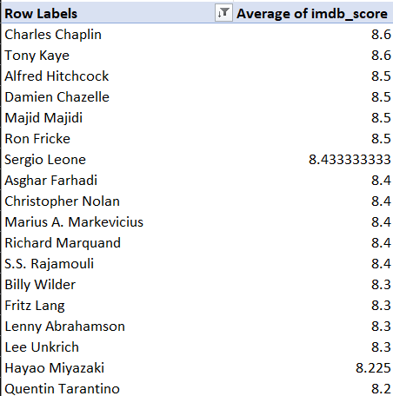
D. Best Directors: Group the column using the director_name column. Find out the top 10 directors for whom the mean of imdb_score is the highest and store them in a new column top10director. In case of a tie in IMDb score between two directors, sort them alphabetically. Your task: Find the best directors
The column ‘director_name’ is grouped using Pivot Table.
Number of rows= 1752

Slide 18
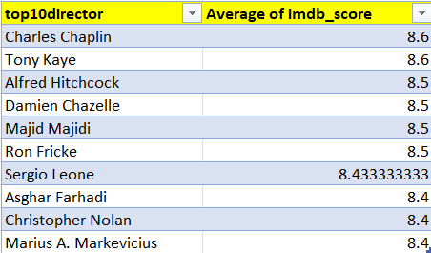
The Top 10 Directors with highest mean of imdb_score is obtained, sorted using the ‘Sort’ function and stored in a new column ‘top10director’.

Slide 19
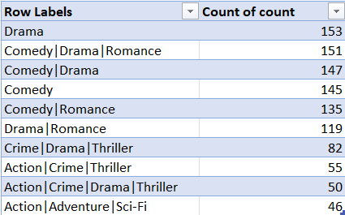
E. Popular Genres: Perform this step using the knowledge gained while performing previous steps. Your task: Find popular genres
The column ‘genres’ is selected and the number of occurrences are determined using ‘COUNT’ function. Then, a Pivot Table is created, sorted based on count value and the top popular genres are selected.

Slide 20
F. Charts: Create three new columns namely, Meryl_Streep, Leo_Caprio, and Brad_Pitt which contain the movies in which the actors: 'Meryl Streep', 'Leonardo DiCaprio', and 'Brad Pitt' are the lead actors. Use only the actor_1_name column for extraction. Also, make sure that you use the names 'Meryl Streep', 'Leonardo DiCaprio', and 'Brad Pitt' for the said extraction. Append the rows of all these columns and store them in a new column named Combined. Group the combined column using the actor_1_name column. Find the mean of the num_critic_for_reviews and num_users_for_review and identify the actors which have the highest mean. Observe the change in number of voted users over decades using a bar chart. Create a column called decade which represents the decade to which every movie belongs to. For example, the title_year year 1923, 1925 should be stored as 1920s. Sort the column based on the column decade, group it by decade and find the sum of users voted in each decade. Store this in a new data frame called df_by_decade. Your task: Find the critic-favorite and audience-favorite actors

Slide 21
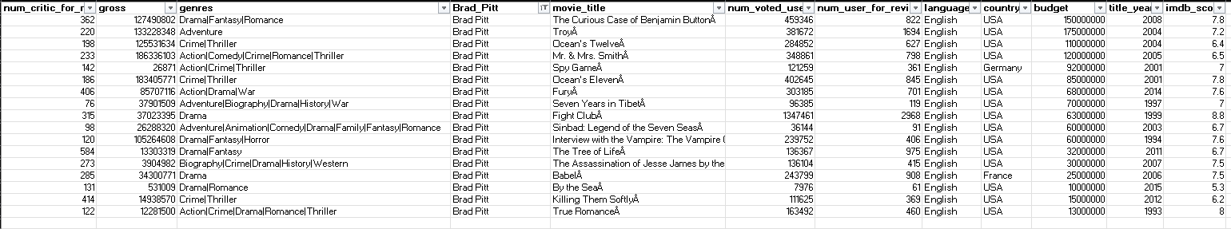
Actor: Brad Pitt

Slide 22
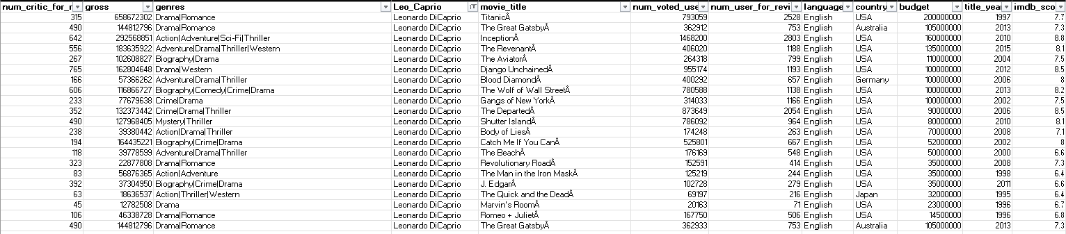
Actor: Leonardo DiCaprio

Slide 23
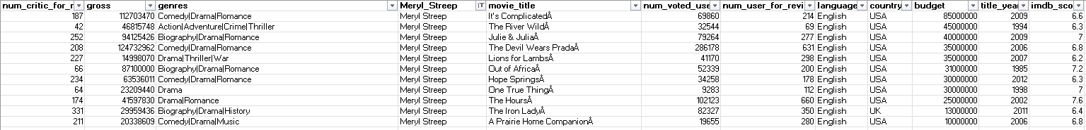
Actor: Meryl Streep

Slide 24
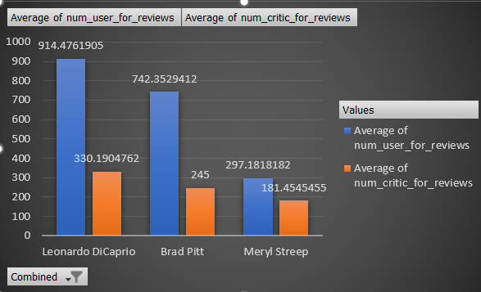
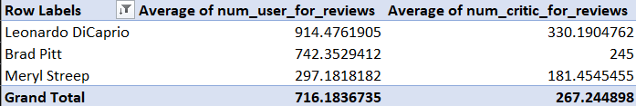
Actor with highest Mean: Leonardo DiCaprio
Critic-Favorite and Audience-Favorite Actor: Leonardo DiCaprio

Slide 25
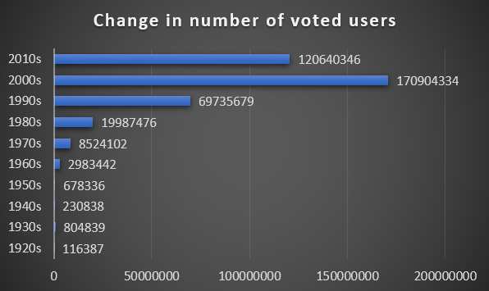
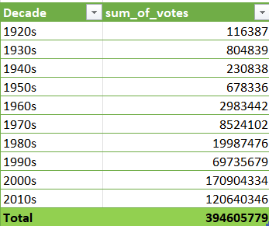
The change in number of voted users is observed using Pivot Table and Bar Graph.

Slide 26
The End

